Slide 1
Radio Frequency Signal Generator
By: Ethan Cura, Abel Gonzalez, Joseph Hinz and James Taylor
Notes:
James

Slide 2
Purpose
The goal of this project is to supplement the existing market with a low-cost RF signal generator for students and enthusiasts.
Notes:
James

Slide 3
Technical Summary
The signal generator shall have a frequency range between 1 and 500MHz with 1Hz precision.
The signal generator shall be able to frequency and amplitude modulate this carrier frequency.
The signal generator shall minimize any spurious signals for a spectrally pure output.
Notes:
Abel

Slide 4
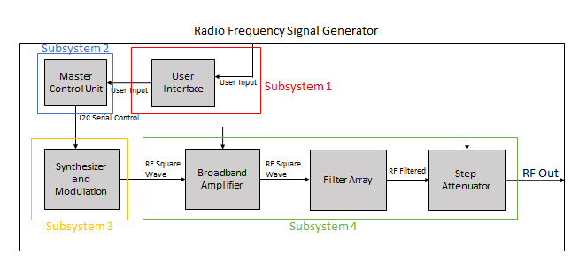
System Overview
Subsystem 1: Ethan Cura
Subsystem 2: Abel Gonzalez
Subsystem 3: Joseph Hinz
Subsystem 4: James Taylor
Notes:
Ethan

Slide 5
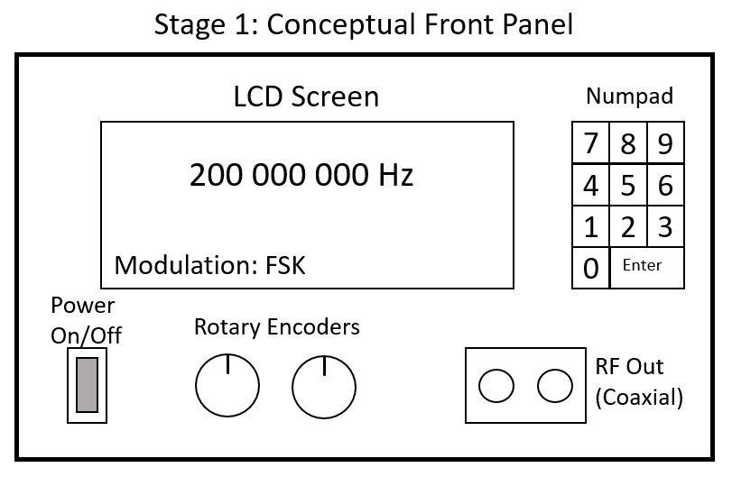
Subsystem 1: User Interface
Parts picked out and ordered
Electronic Schematic finished
PCB Layout in progress
Notes:
Ethan- All of the parts for the User inter faced have been picked and ordered. Once the parts arrive I can test the preliminary UI design on a bread board. I have finished the electronic schematic for the UI within KI-Cad. I am currently working on the footprint layouts for the MCU. Once I have that completed I will have all the necessary parts to determine the layout for the PCB.

Slide 6
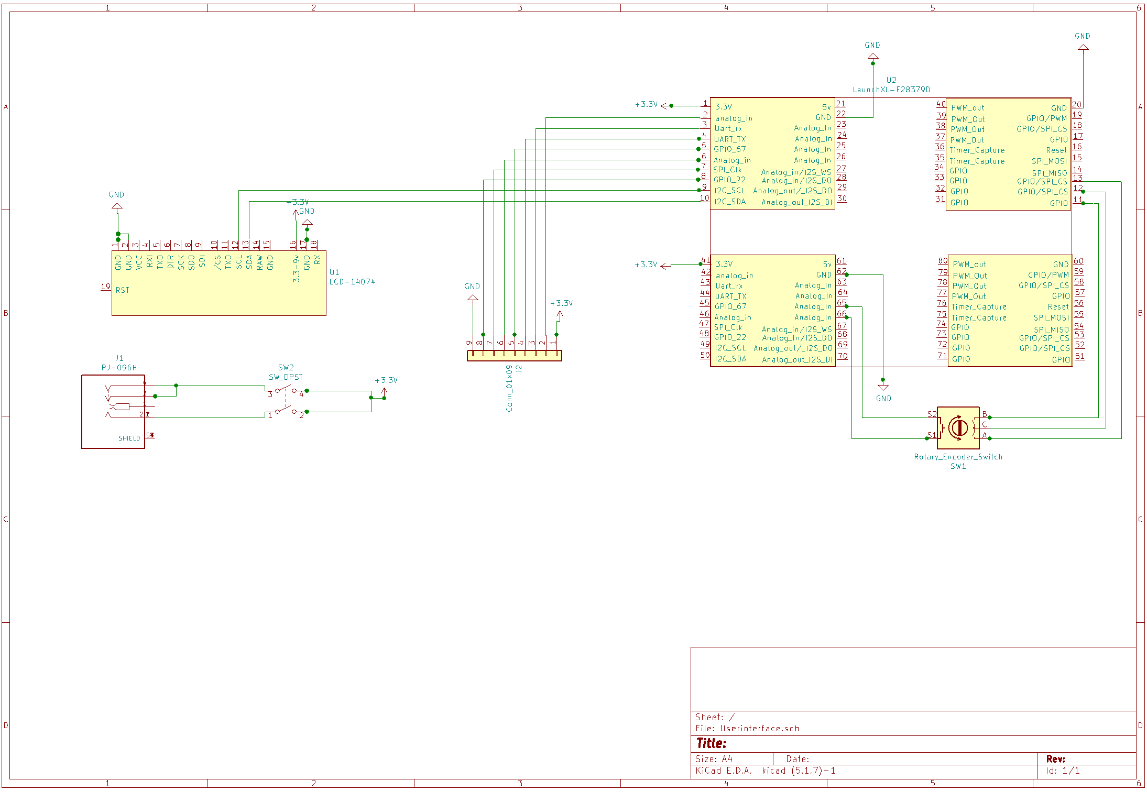

Slide 7
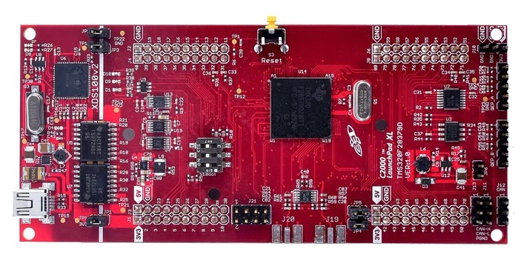
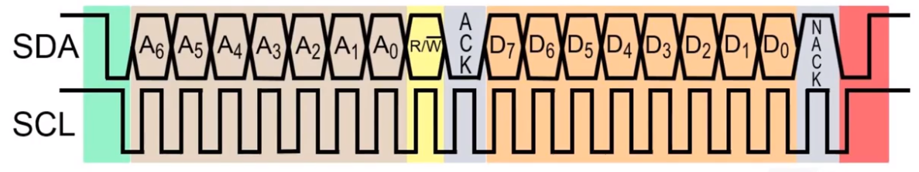
Subsystem 2: Master Control Unit
I2C Control Signals
Read/Write Functions
I2CA_WriteToReg
I2CA_ReadFromReg
Next Step: Accepting User Input
Notes:
Controls the synthesizer, modulation, filter selection, and appropriate attenuation
Abel

Slide 8
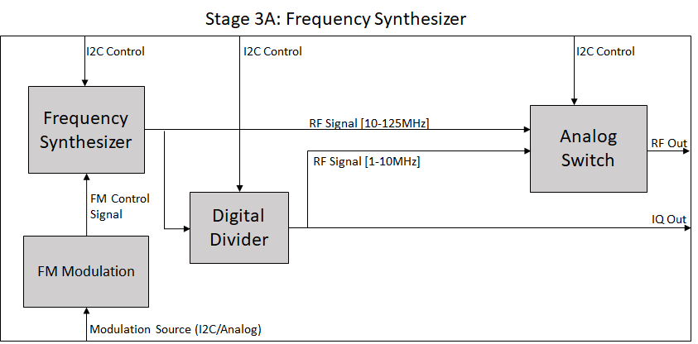
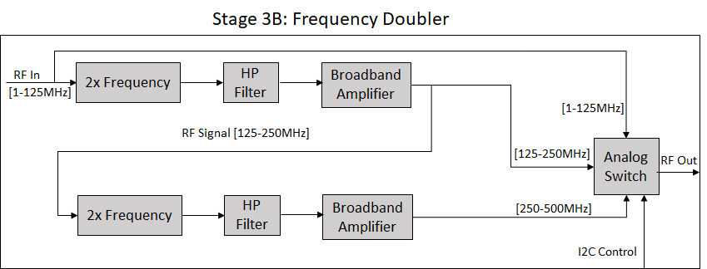
Subsystem 3: Synthesizer and Modulation
Frequency Synthesizer generates square wave of desired frequency
Divider allows for lower minimum frequency on synthesizer
Modulation system will modulate data from MCU onto the carrier
Frequency Doubler will increase frequency from synthesizer.
Analog switch will choose between these outputs
Notes:
Joe

Slide 9
Subsystem 3: Progress
Developed the Synthesizer and Frequency Doubler schematics and PCB layouts in KiCad.
Sent the designs off for fabrication.

Slide 10
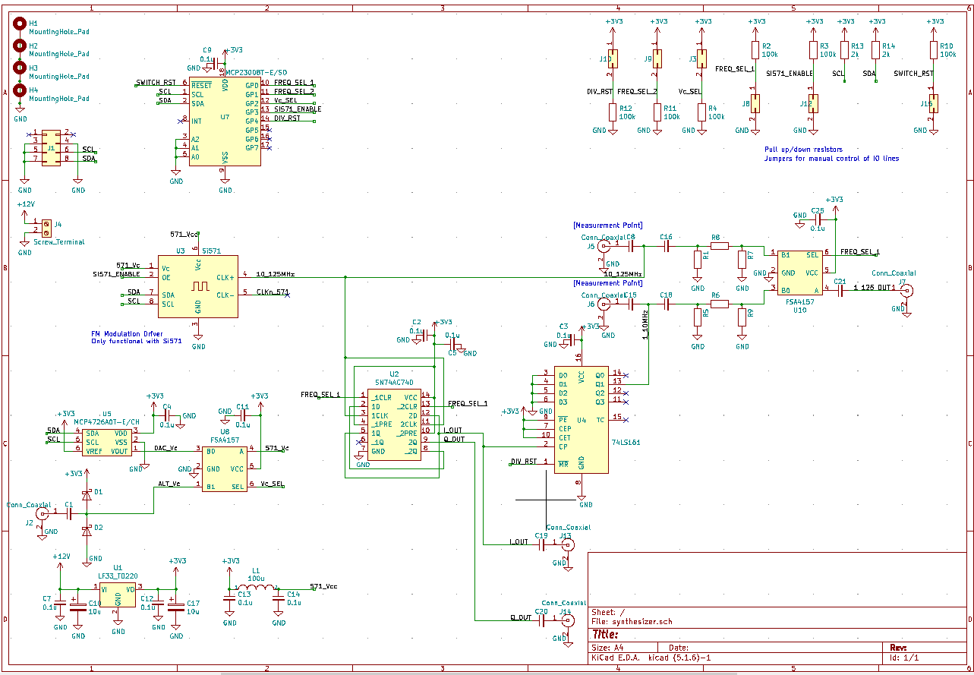

Slide 11
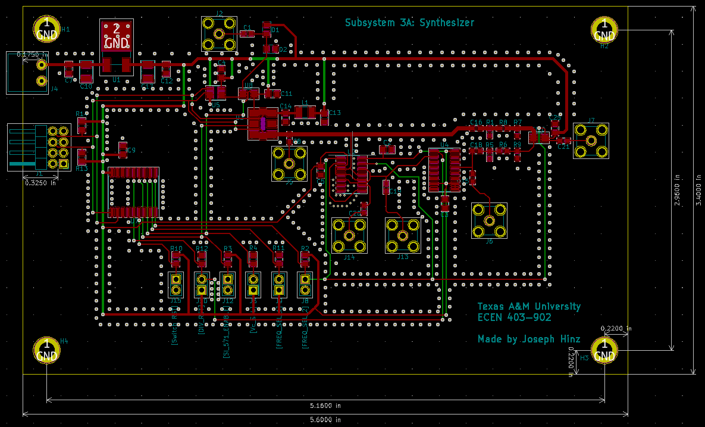

Slide 12
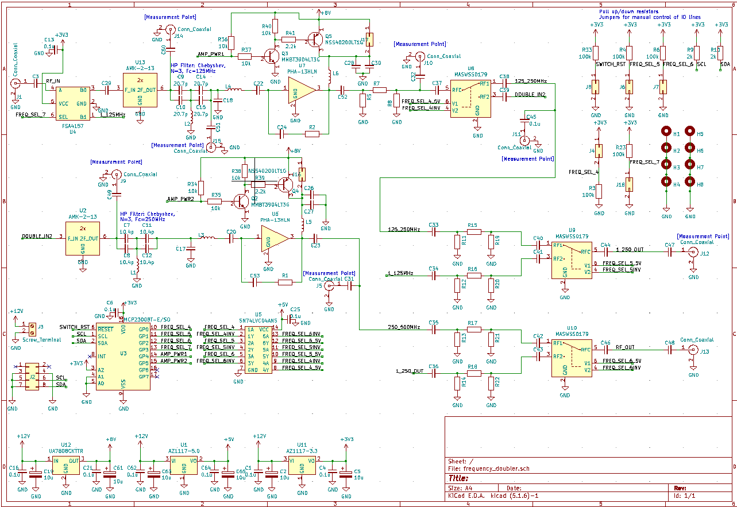

Slide 13
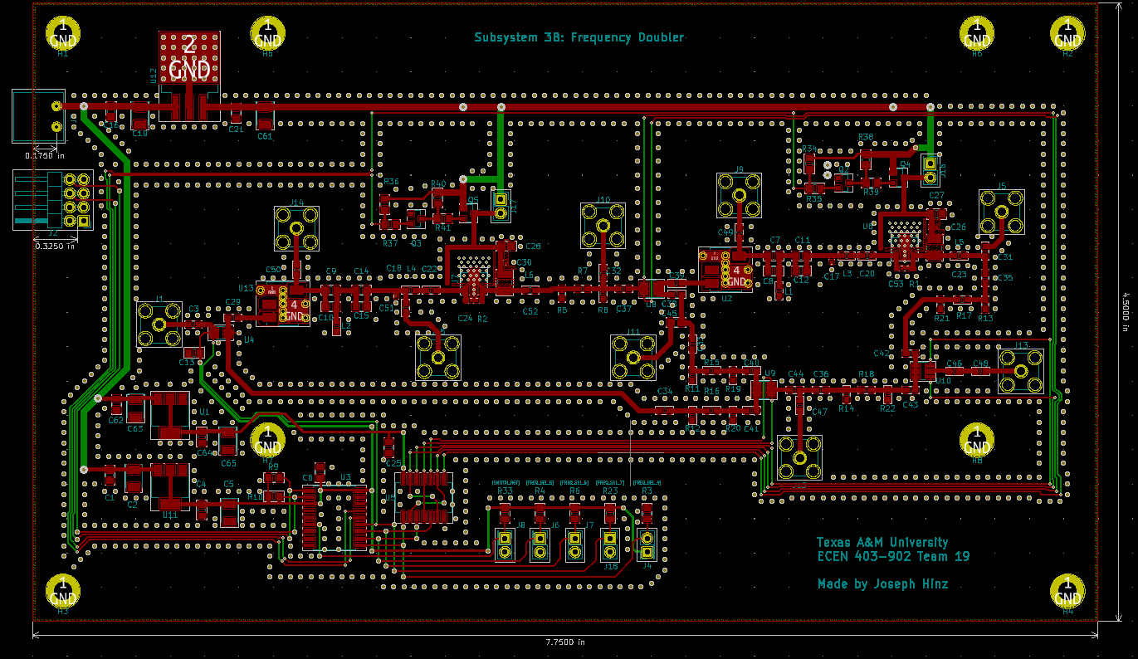

Slide 14
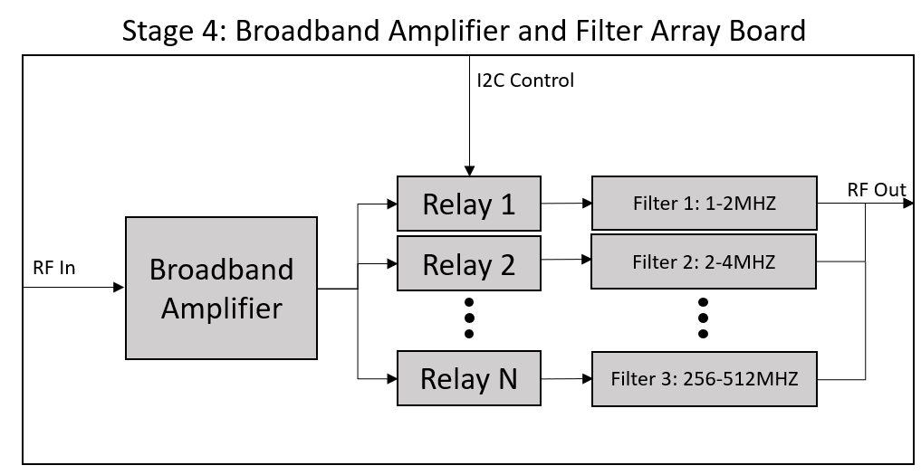
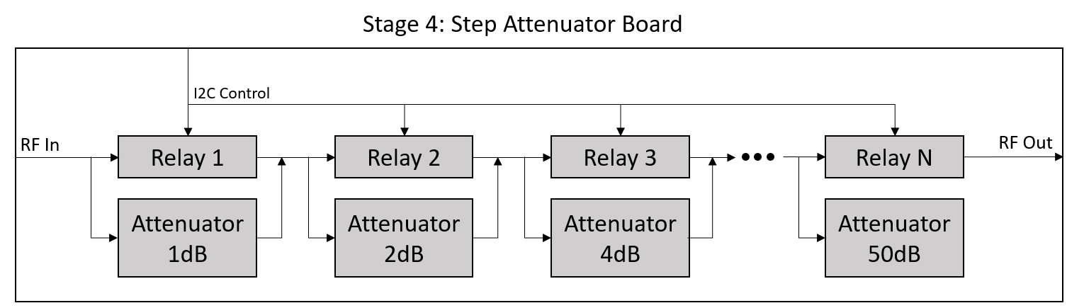
Subsystem 4: Broadband Amplifier/Filter Array/Step Attenuator
Amplifier increases the power of the carrier/modulated signal
Filters remove unwanted harmonics from square wave signal to produce a sinusoidal carrier
Attenuators reduce signal power to the user defined output power
Notes:
James

Slide 15
Subsystem 4: Broadband Amplifier/Filter Array/Step Attenuator
Subsystem will be built on four PCBs
One board for amplifier, two for filters, one for attenuator
Working on KiCad schematics/layout for the three PCBs for the amplifier and filters
Associating footprints
Finalizing details relating to the power supply for the amplifiers and I2C control of the relays
Attenuator work has been delayed
Notes:
James

Slide 16
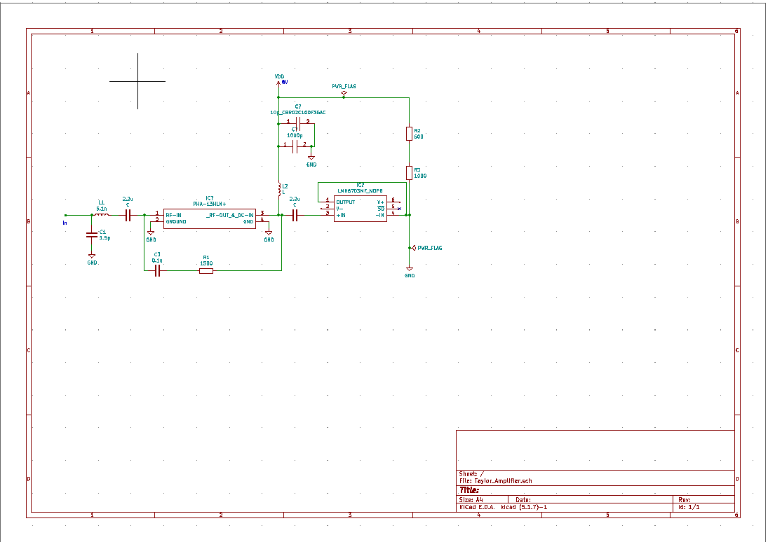

Slide 17
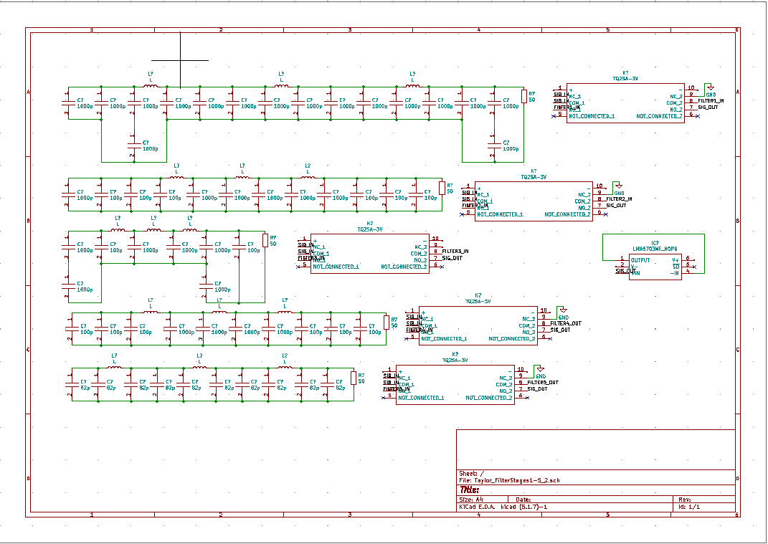

Slide 18
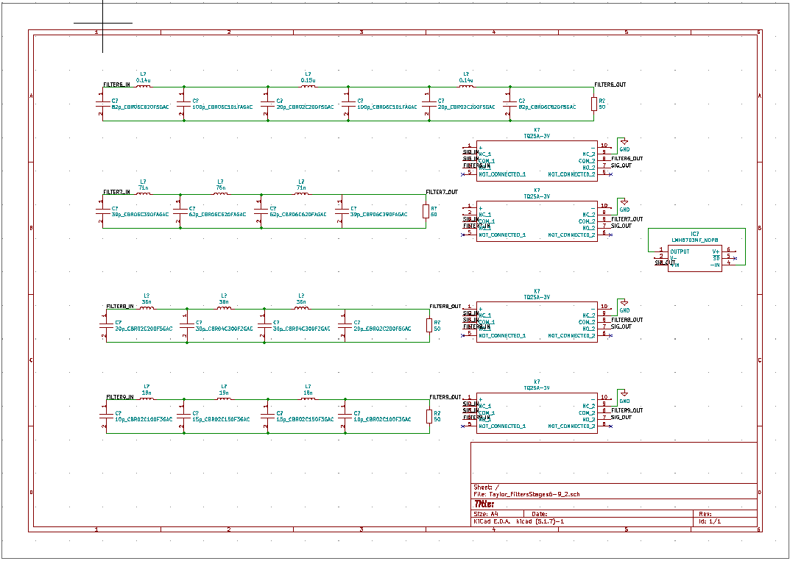

Slide 19
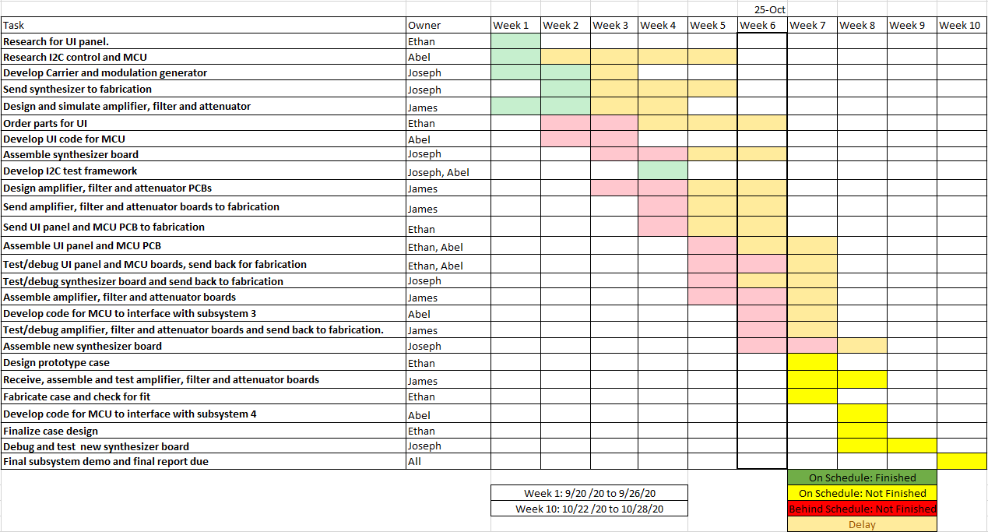
Execution and Validation

Slide 20
Takeaways
Subsystem 1:
Documentation is an important part of picking parts for PCB design
Subsystem 2:
There are multiple methods of communication between devices
Subsystem 3:
Increasing frequency range dramatically increases complexity.
Larger boards means much larger production costs.
Subsystem 4:
High precision can be challenging
Finding components with the desired frequency range can be challenging

Slide 21
Questions

Slide 22
Thank You

